Slide 1
Amazon Web Service Reference Architectures
By ALTOTECH

Slide 2
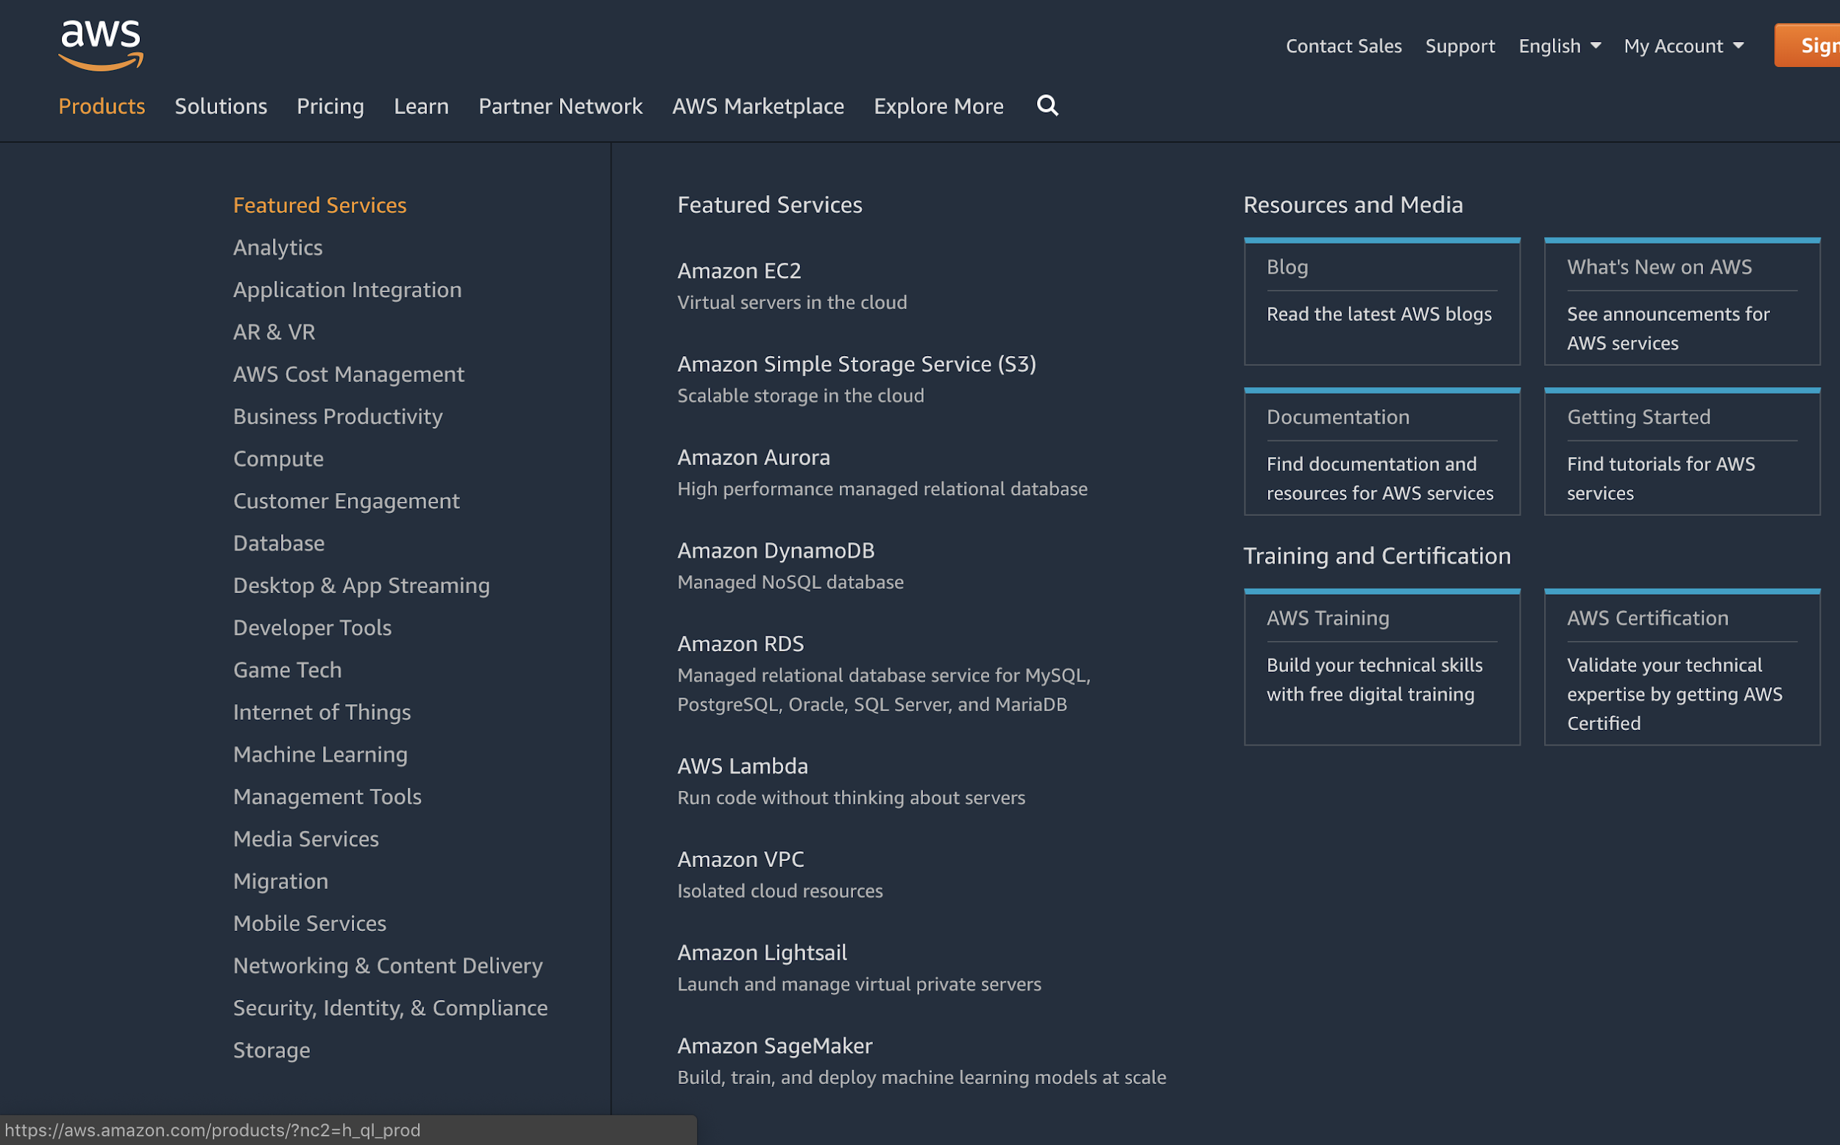
Amazon Web Service
Cloud service

Slide 3
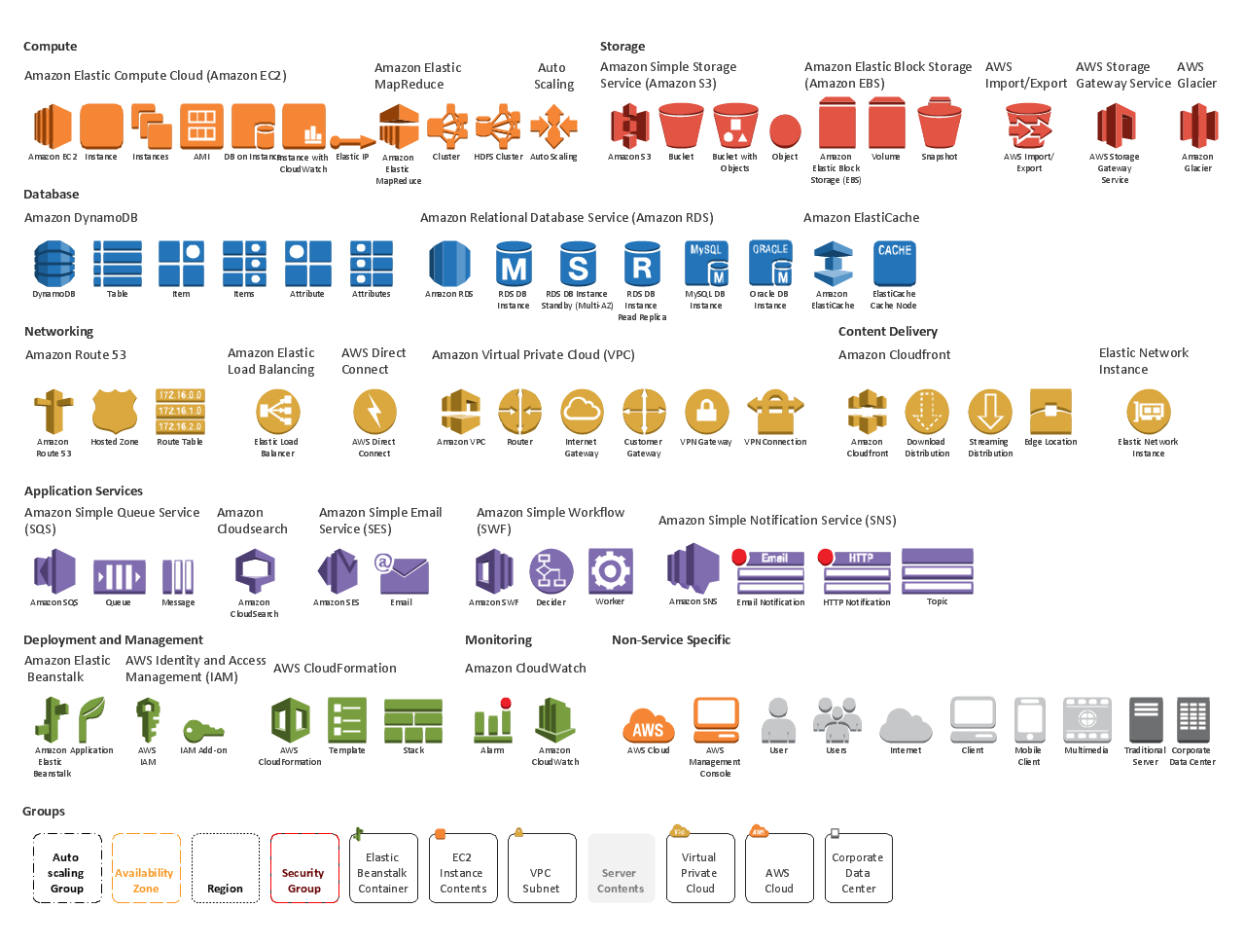

Slide 10
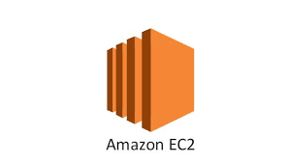
Amazon Elastic Compute Cloud (EC2)
Instances
secure, resizable compute capacity in the cloud
It is designed to make web-scale cloud computing easier for developers.

Slide 11
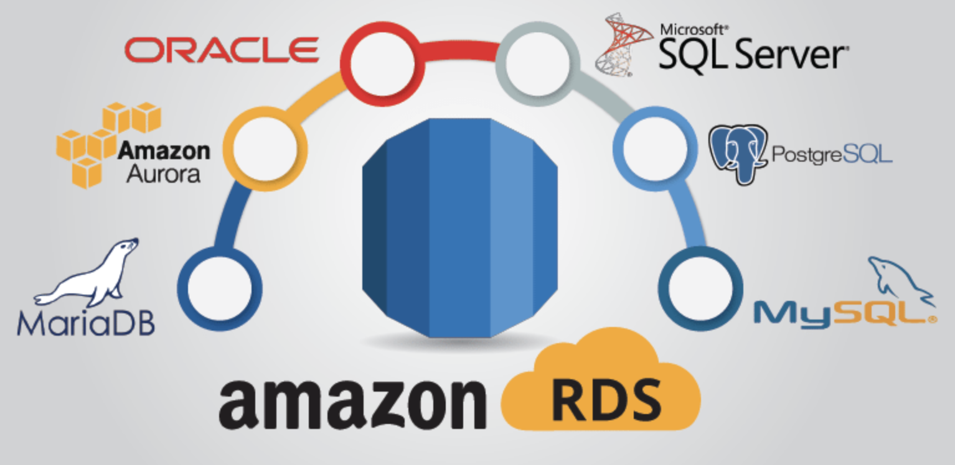
Amazon Relational Database Service (RDS)
provides cost-efficient and resizable capacity
automates administration tasks such as hardware provisioning, database setup, patching and backups

Slide 12

Amazon Simple Storage Service (S3)
object storage built to store and retrieve any amount of data

Slide 13
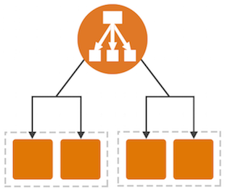
Elastic Load Balancing
handle the varying load of your application traffic in a single Availability Zone or across multiple Availability Zones
high availability, automatic scaling, and robust security

Slide 14
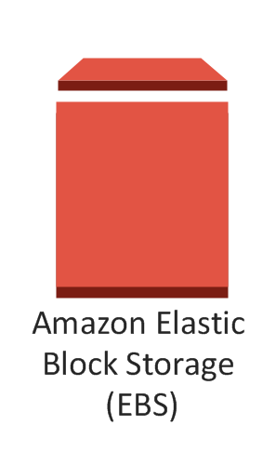
Amazon Elastic Block Store
provides persistent block storage volumes for use with Amazon EC2 instances in the AWS Cloud
EBS volume is automatically replicated within its Availability Zone to protect you from component failure
Like HDD, SSD

Slide 15
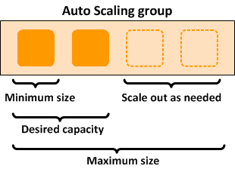
AWS Auto Scaling
automatically adjusts capacity to maintain steady, predictable performance at the lowest possible cost

Slide 16
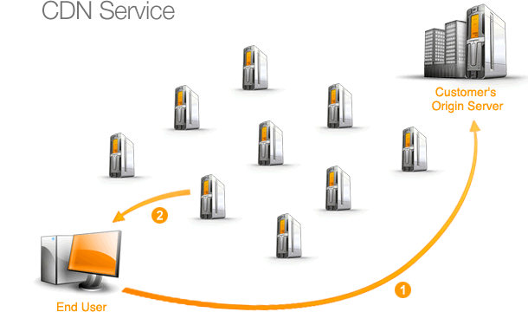

Amazon CloudFront
fast content delivery network (CDN) service that securely delivers data, videos, applications, and APIs to customers globally with low latency, high transfer speeds

Slide 17
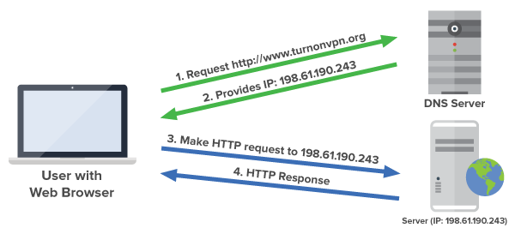

Amazon Route 53
highly available and scalable cloud Domain Name System (DNS) web service

Slide 18
WEB APPLICATION HOSTING

Slide 19
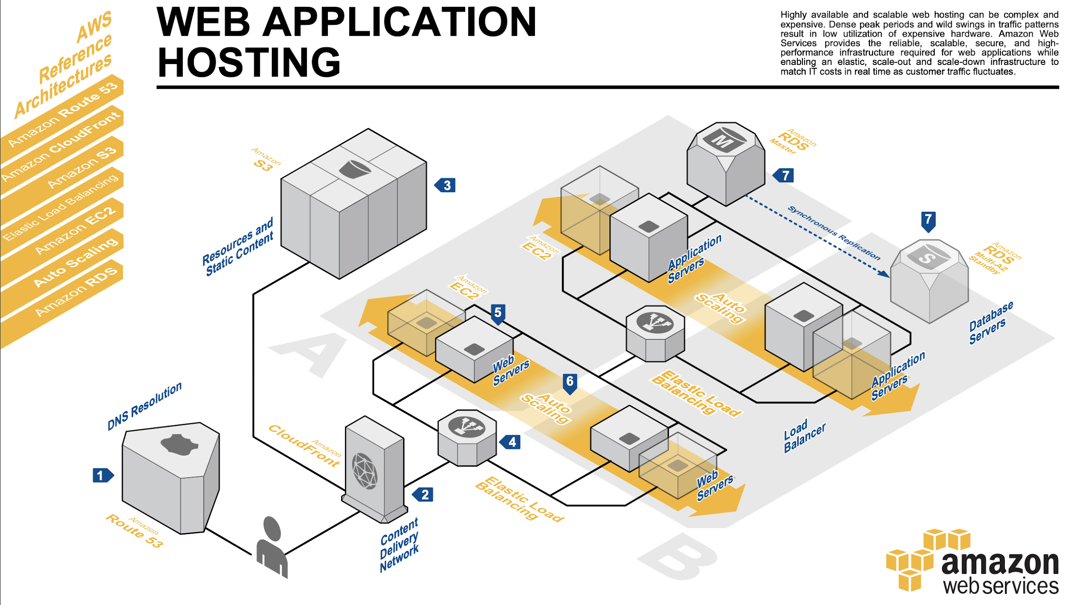

Slide 20
The user’s DNS requests are served by Amazon Route 53

Slide 21
Content is delivered by Amazon CloudFront

Slide 22
Resources and static content are stored on S3

Slide 23
HTTP requests are first handled by Elastic Load Balancing

Slide 24
Web servers and application servers are deployed on EC2

Slide 25
Auto Scaling automatically adjust your capacity up or down

Slide 26
RDS that contains application’s data is hosted redundantly on a multi availability zones

Slide 27
CONTENT AND MEDIA SERVING

Slide 28
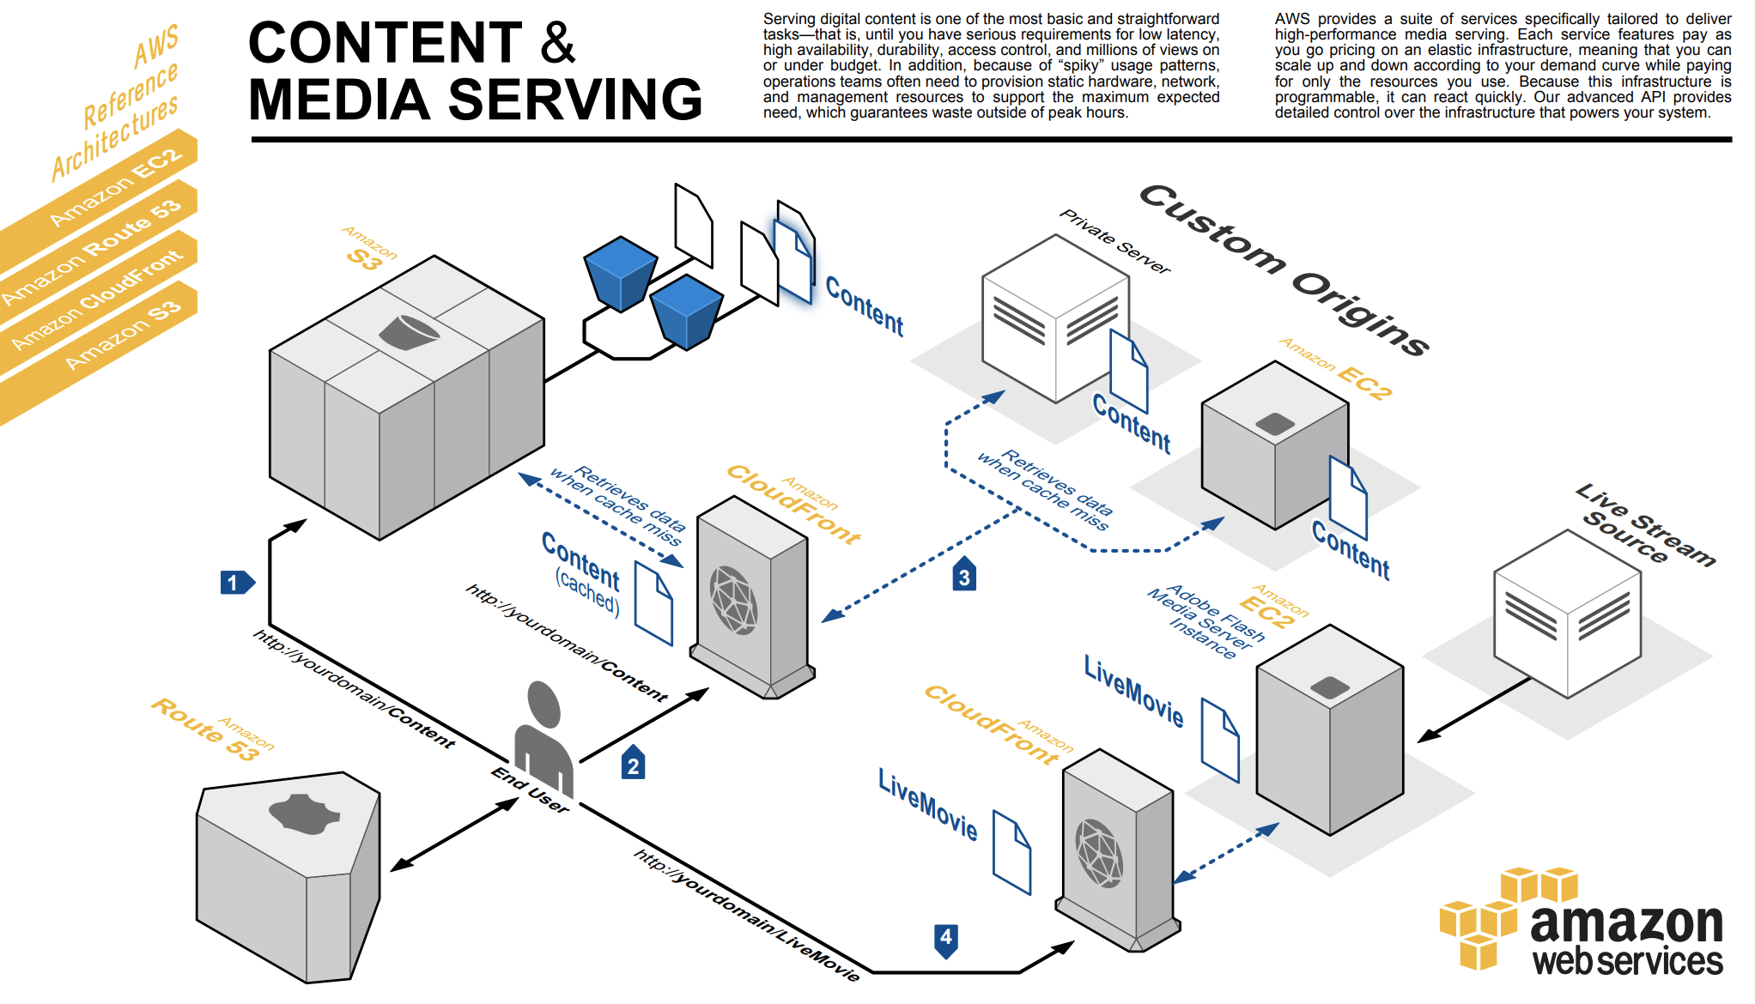
Content

Slide 29
Cached

Slide 30
Cache miss

Slide 31
Live Stream

Slide 32
FAULT TOLERANCE
&
HIGH AVAILABILITY

Slide 33
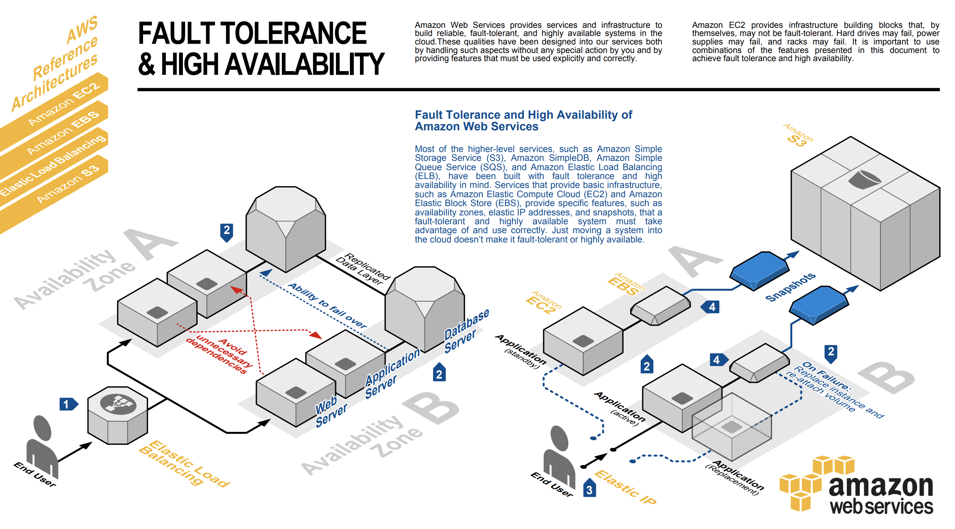
Place EC2 in multiple AZs
Avoid dependencies

Slide 34
Let’s play the game !

Slide 35
IMAGE RECOGNITION & PROCESSING

Slide 36
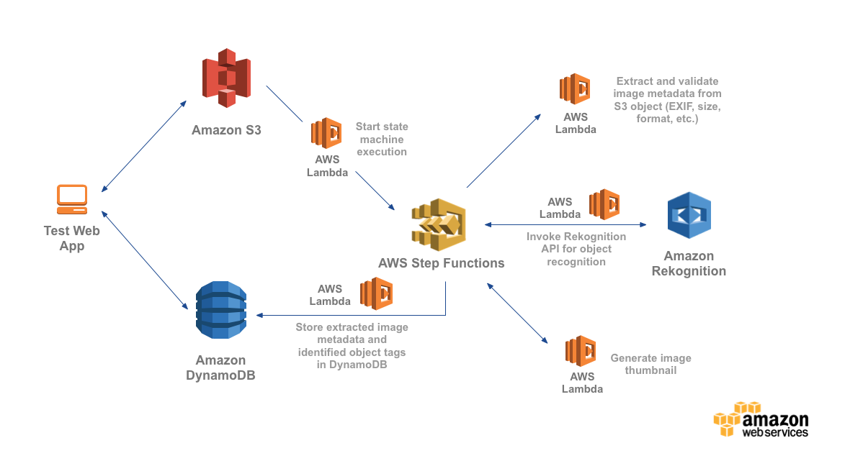
IMAGE RECOGNITION & PROCESSING
Notes:
IMAGE RECOGNITION & PROCESSING

Slide 37
IMAGE RECOGNITION & PROCESSING
Notes:
IMAGE RECOGNITION & PROCESSING

Slide 38
IMAGE RECOGNITION & PROCESSING
Notes:
IMAGE RECOGNITION & PROCESSING

Slide 39
IMAGE RECOGNITION & PROCESSING
Notes:
IMAGE RECOGNITION & PROCESSING

Slide 40
IMAGE RECOGNITION & PROCESSING
Notes:
IMAGE RECOGNITION & PROCESSING

Slide 41
IMAGE RECOGNITION & PROCESSING
Notes:
IMAGE RECOGNITION & PROCESSING

Slide 42
IMAGE RECOGNITION & PROCESSING
Notes:
IMAGE RECOGNITION & PROCESSING

Slide 43
IMAGE RECOGNITION & PROCESSING
Notes:
IMAGE RECOGNITION & PROCESSING

Slide 44
IMAGE RECOGNITION & PROCESSING
Notes:
IMAGE RECOGNITION & PROCESSING

Slide 45
IMAGE RECOGNITION & PROCESSING
Notes:
IMAGE RECOGNITION & PROCESSING

Slide 46
IMAGE RECOGNITION & PROCESSING

Slide 47
IMAGE MODERATION CHATBOT

Slide 48
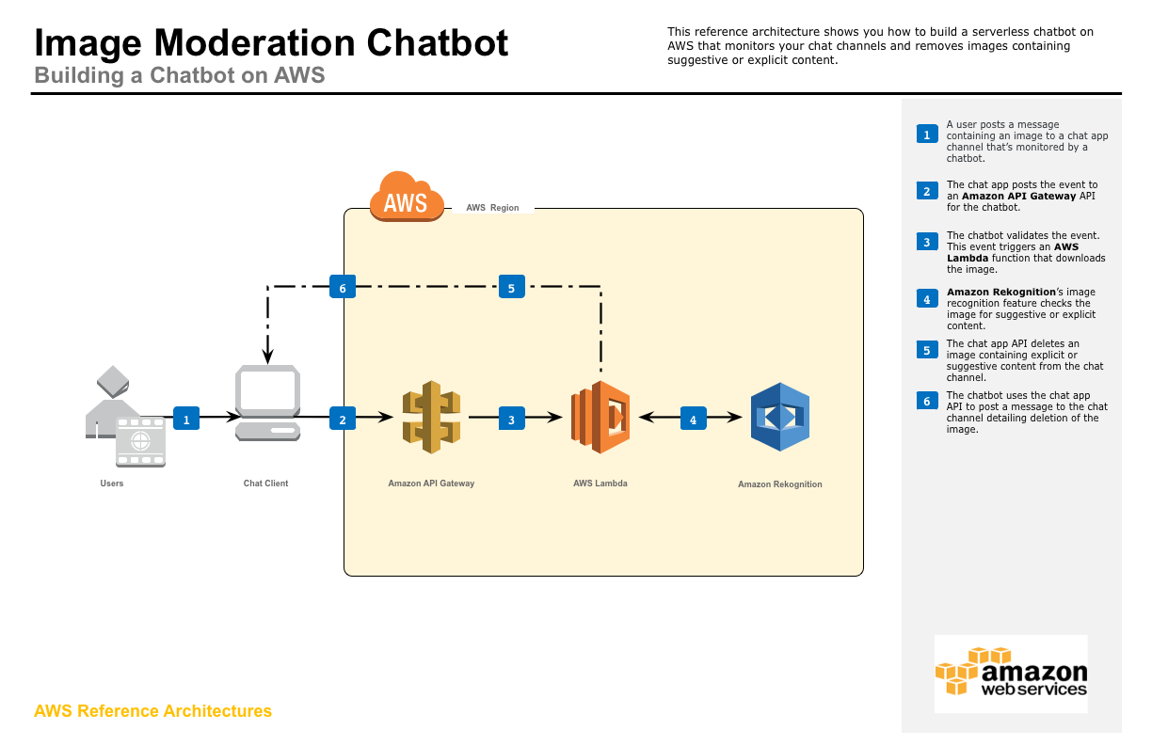

Slide 53
SERVERLESS WEB APPLICATION

Slide 54
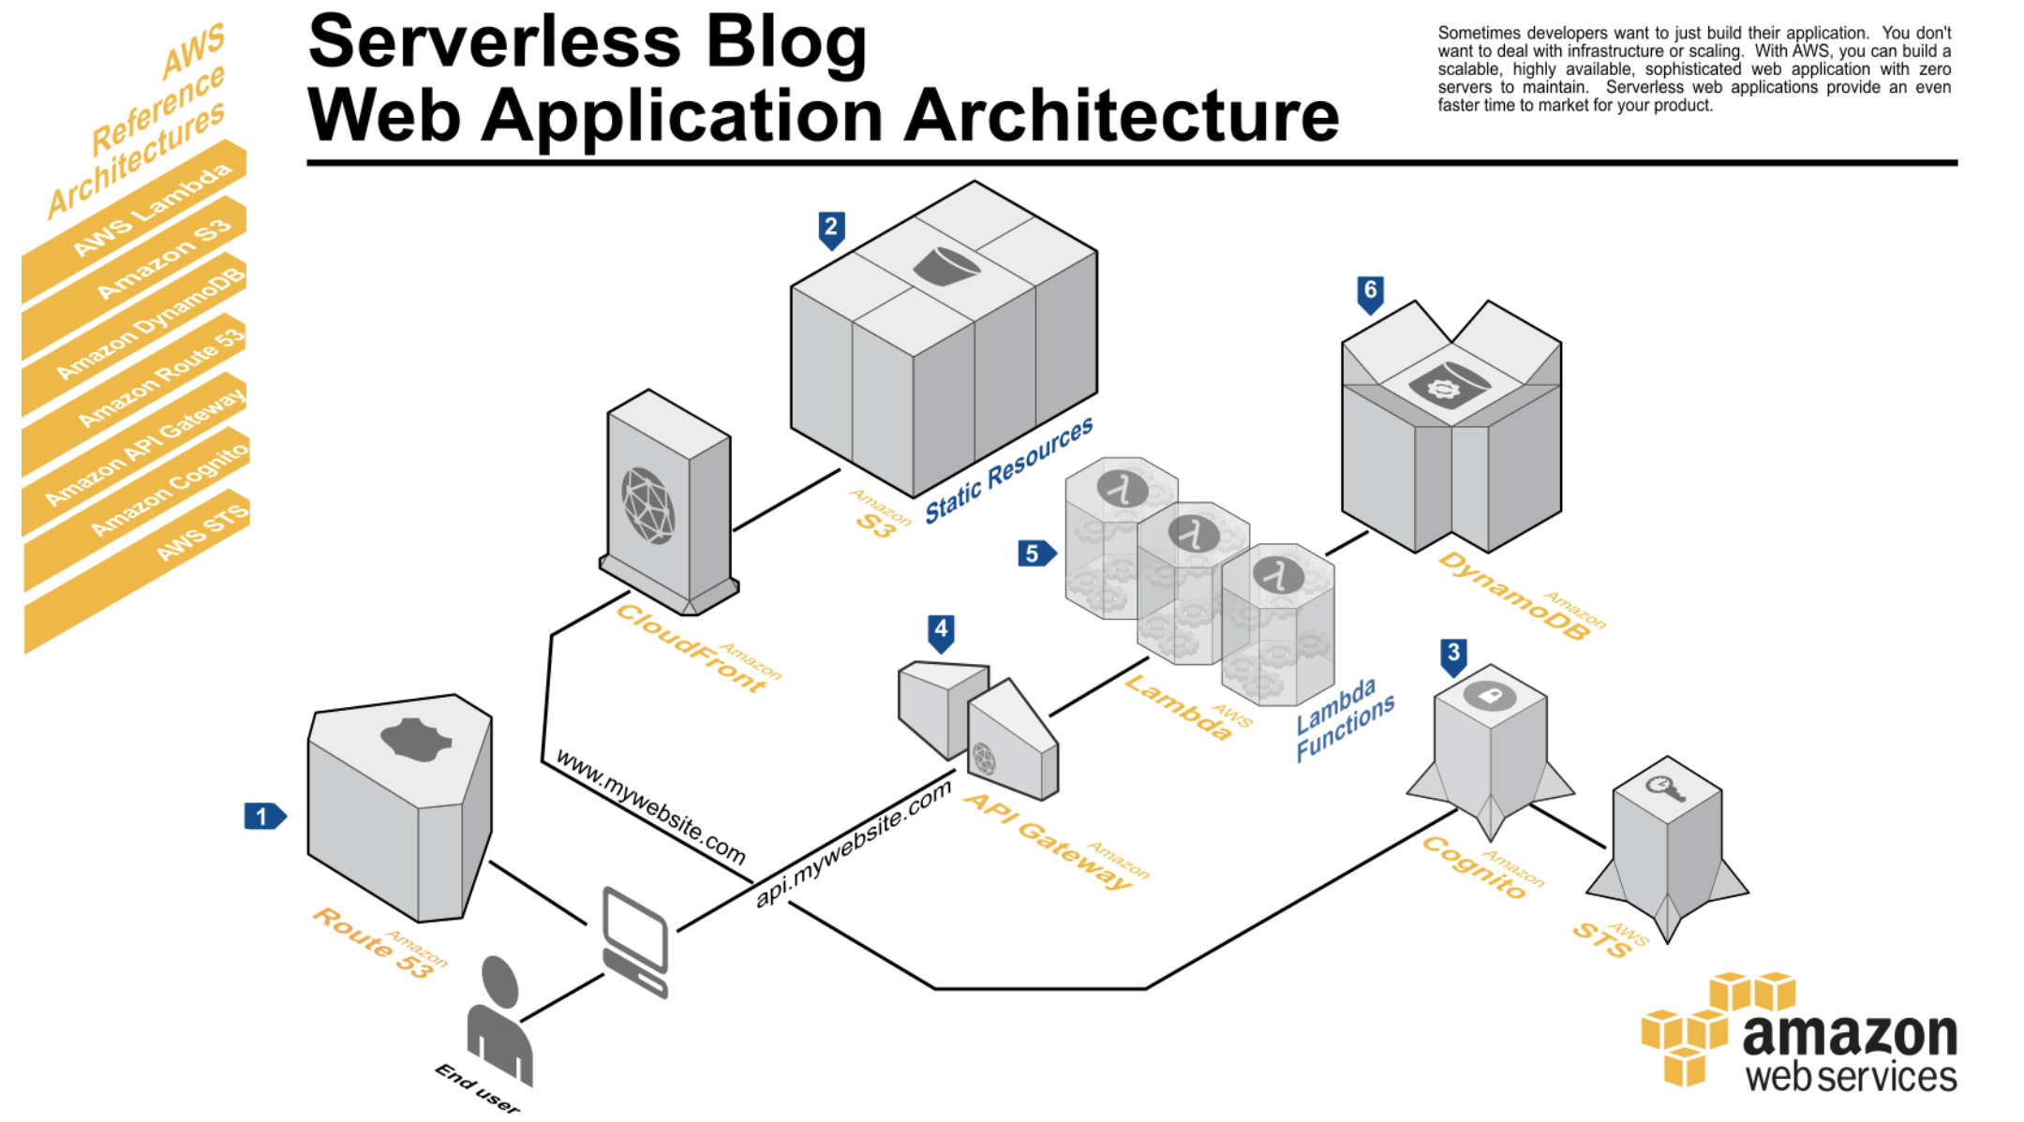

Slide 63
FILE SYNCHRONIZATION SERVICE

Slide 64
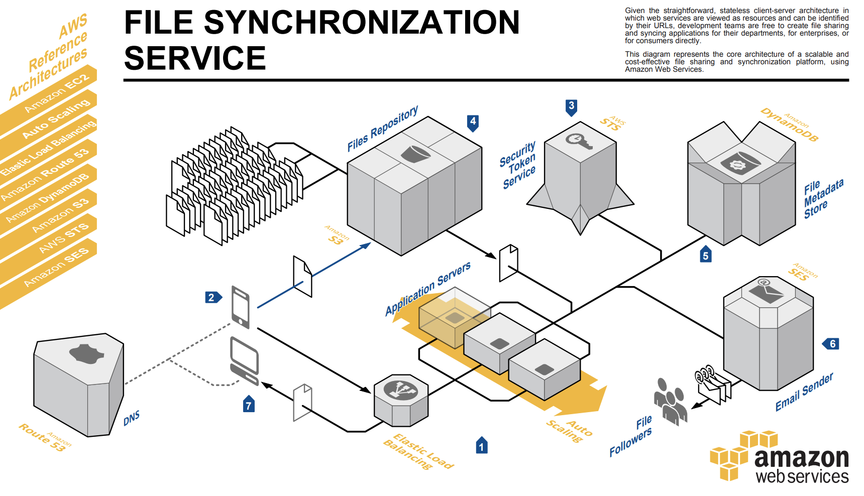

Slide 72
REAL-TIME FILE PROCESSING

Slide 73
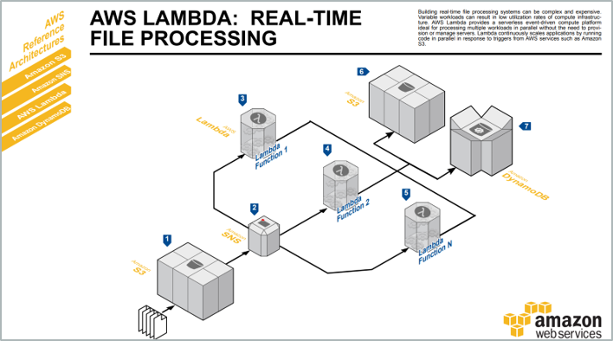

Slide 79
WEB LOG ANALYSIS

Slide 80
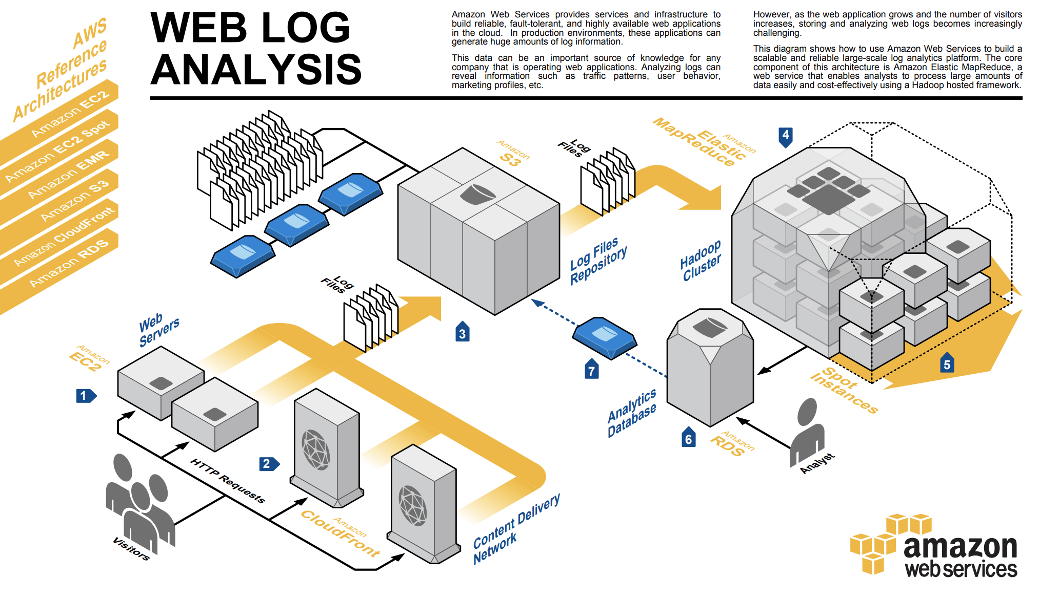

Slide 87
REAL-TIME STREAM PROCESSING

Slide 88
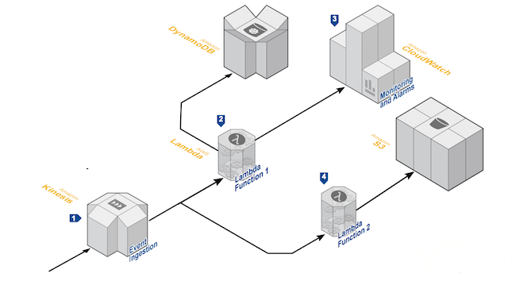
Amazon DynamoDB
Amazon CloudWatch
Amazon S3
AWS Lambda
Amazon Kinesis

Slide 89
Amazon DynamoDB
Amazon CloudWatch
Amazon S3
AWS Lambda
Amazon Kinesis

Slide 90
Amazon DynamoDB
Amazon CloudWatch
Amazon S3
AWS Lambda
Amazon Kinesis

Slide 91
Amazon DynamoDB
Amazon CloudWatch
Amazon S3
AWS Lambda
Amazon Kinesis

Slide 92
Amazon DynamoDB
Amazon CloudWatch
Amazon S3
AWS Lambda
Amazon Kinesis

Slide 93
Amazon DynamoDB
Amazon CloudWatch
Amazon S3
AWS Lambda
Amazon Kinesis

Slide 94
E-COMMERCE WEB SITE
PART 1: FRONTEND

Slide 95
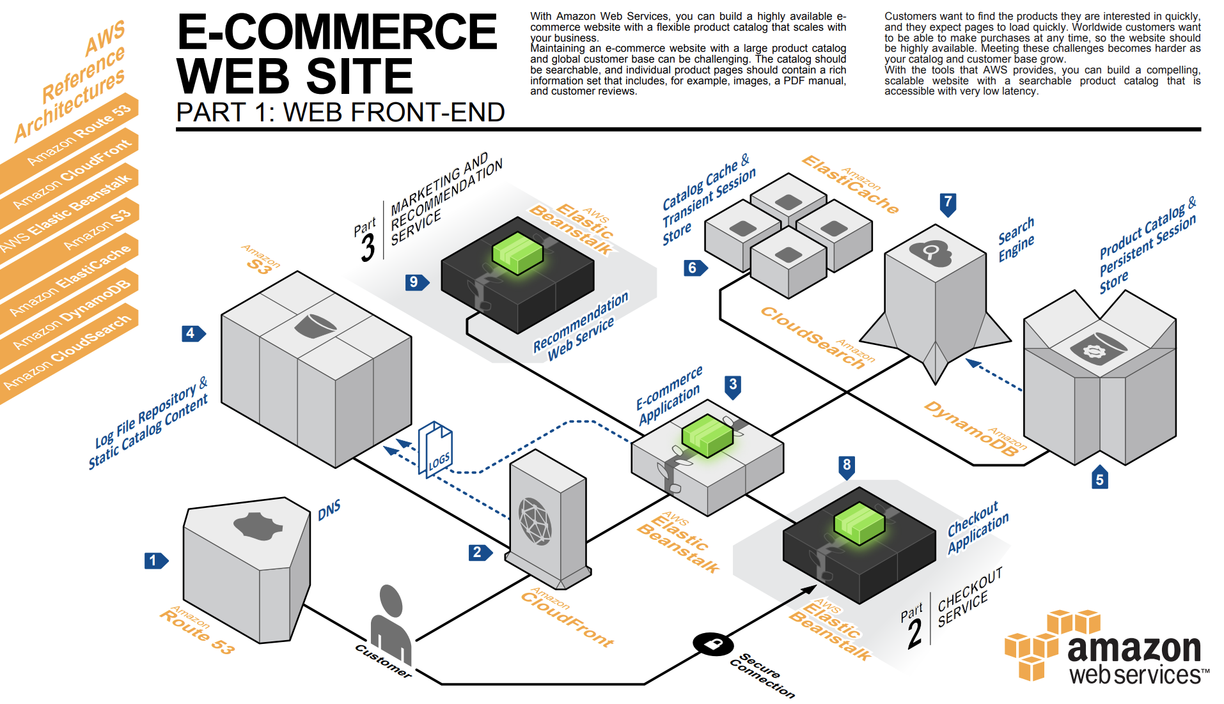

Slide 105
E-COMMERCE WEB SITE
PART 2: CHECKOUT SERVICE

Slide 106
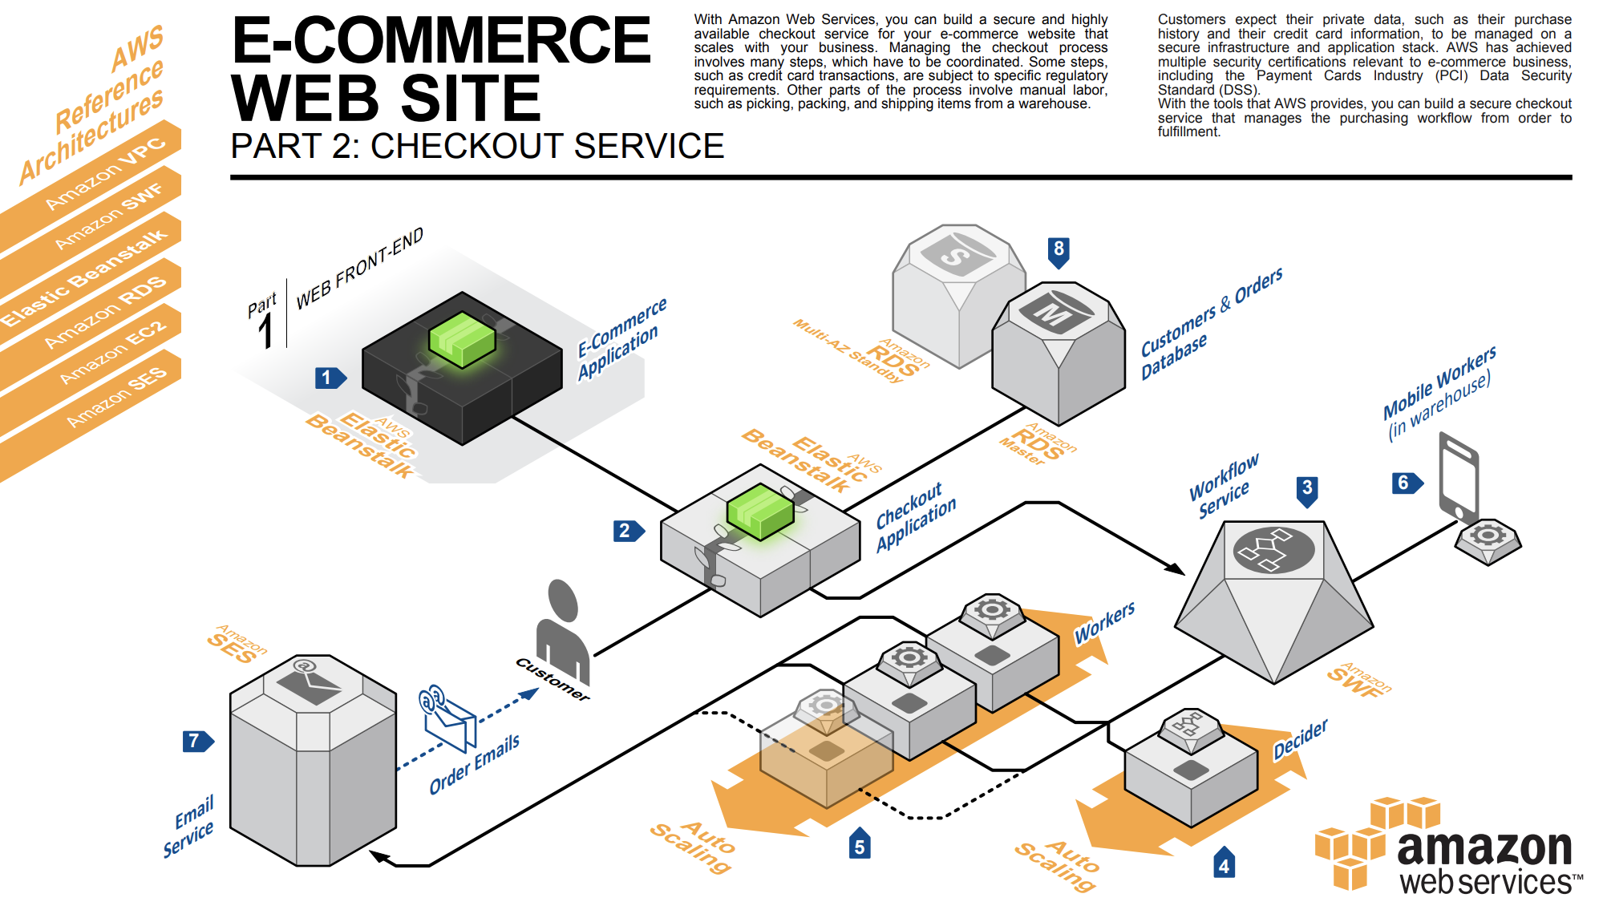

Slide 115
E-COMMERCE WEB SITE
PART 3: MARKETING & RECOMMENDATIONS

Slide 116
